Slide 1
Plots 53 & 54, Brent Terrace

Slide 2
Introductions
Chris Thwaite – Construction Manager
Karl David - Project Manager
Gary Akers - Snr Design & Technical Manager
Paul Davies - Design & Technical Manager
Simone Taylor – Regeneration Coordinator
Toni Hodson – Ass. Project Manager

Slide 3
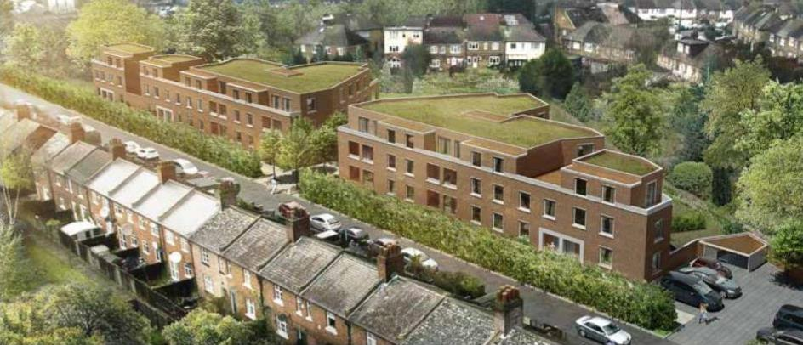
Plots 53 & 54
47 new homes for existing Whitefields Estate residents

Slide 4
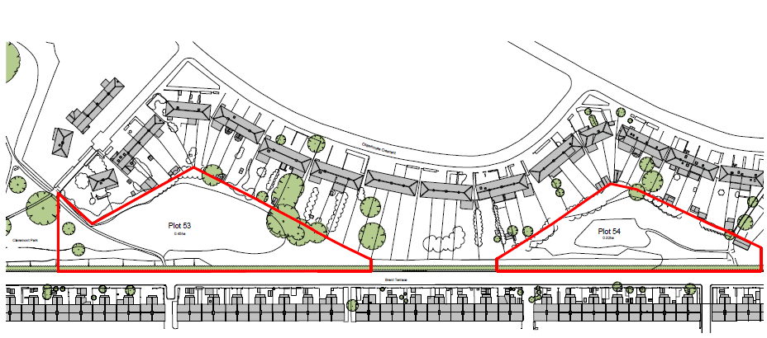
Plots 53 & 54

Slide 5
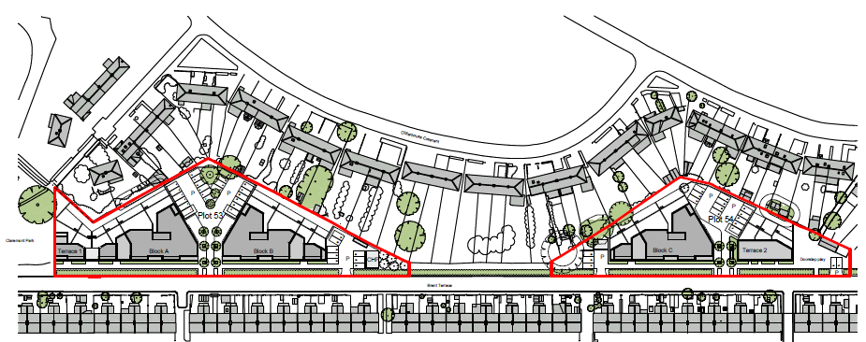
Plots 53 & 54
Plot 53 – 30 Homes
Plot 54 – 17 Homes

Slide 6
Communications Strategy with Whitefield & Brent Terrace Residents
Following L&Q starting on site there will be:
Regular Surgeries
Regular Newsletters
Site Noticeboard
Attend & Update Residents Meetings
Consultation Events: Meet the team opportunities
Resident Liaison: One point of contact for resident queries.

Slide 7
Site Surveys
What are we doing now?
Designing the foundations
Undertaking surveys
- Boreholes to determine the ground beneath the site
- Drainage investigations
Further surveys to be completed
Earth bunds to be reinstated
Notes:
6.1 (8 Floors) 6.2 (9 Floors)
Community Centre Early Start
L&Q Office Retail A
Café Retail B
Dentist Gym
Youth Centre Nursery
Sainsbury’s Medical Centre

Slide 8
Potential Impact for Residents
Increased vehicle movements
Noise
Dust & Vibration
Parking
Unloading and distribution
Notes:
6.1 (8 Floors) 6.2 (9 Floors)
Community Centre Early Start
L&Q Office Retail A
Café Retail B
Dentist Gym
Youth Centre Nursery
Sainsbury’s Medical Centre

Slide 9
Mitigation Measures – Vehicle Movements
Traffic Marshalls available
Deliveries on smaller vehicles
Deliveries outside of peak times
Off site holding area
Delivery booking in system
Notes:
6.1 (8 Floors) 6.2 (9 Floors)
Community Centre Early Start
L&Q Office Retail A
Café Retail B
Dentist Gym
Youth Centre Nursery
Sainsbury’s Medical Centre

Slide 10
Mitigation Measures - Noise
Works within agreed hours
Machinery switched off when not in use
Acoustic shielding for particular noisy activity
Silenced plant
Prefabrication/off site manufacture
No Radios on site
Out of hours working only where agreed in advance

Slide 11
Mitigation Measures – Dust & Vibration
Damping down during dry spells of weather
Road sweeping undertaken at regular intervals
Skips kept covered
Any cutting undertaken with water spray
Vibrating equipment used only where necessary
Cutting and sawing used rather than breaking out
Methodology avoids vibration & dust creation

Slide 12
Mitigation Measures – Parking
Parking management strategy to be produced
Parking limitations advised in orders
Parking controlled by site management
Subcontractors penalised where infringements
Shared use of vehicle scheme
Use of public Transport promoted

Slide 13
Mitigation Measures – Unloading & Distribution
Deliveries unloaded in site boundary where possible
Delivery restrictions advised in orders
Forklift to distribute materials around site
Deliveries made via new access roadway
Vehicles leave site via new access roadway
24 Hr notice for deliveries
7 day notice for larger deliveries

Slide 14
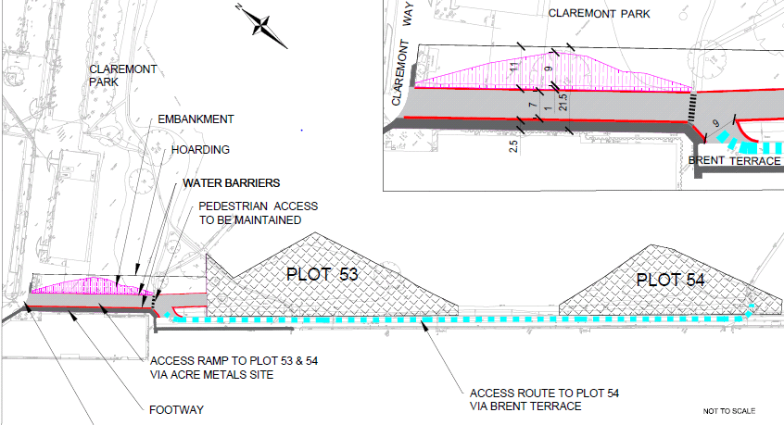
Access to the Surrounding Area

Slide 15
Access to the Surrounding Area

